Slide 1
HCA update
Ribble Valley Borough Council
Nick Cumberland
Senior Area Manager (Lancs. & Cumbria)
23 November 2016

Slide 2
Contents
  HCA in Ribble Valley
  Current HCA funding and programmes
  Turbulent year
  Autumn Statement 2016
  What Government is saying now
  Conclusions

Slide 3
Homes and Communities Agency
“Government’s housing, land and regeneration agency, and the regulator of social housing providers in England”
Four key areas:
  Land
  Affordable Housing
  Recoverable Investment
  Regulation

Slide 4
HCA in Ribble Valley
Affordable Housing (2016/17)
From 1 April 2016 to 31 March 2017, the following affordable housing is currently forecast to be delivered:
42 starts
  32 Affordable Rent and 10 Shared Ownership
111completions
  81 Affordable Rent and 13 Shared Ownership
  10 Affordable Rent Extra Care (Elker Lane, Billington)
  7 Shared Ownership Extra Care

Slide 5
Spending Review (2015) - Current c.£20 billion
  c£8bn to deliver over 400,000 affordable homes
  c£12bn housing investment, including:
HTB: Shared Ownership | £4.1 bn | 135,000
Starter Homes | £2.3 bn | 200,000
Affordable Rent | £1.6 bn | 100,000
Help to Buy Equity Loan | £8.6bn | 145,000
Public Sector Land programme | £1.1 bn | 160,000
Housing Development Fund (SMEs & Cust. Builders) | £1 bn
Long Term Fund | £2.3 bn

Slide 6

Government objectives (Nov 15 -)
Planning and Housing
Ambition for 1m new homes by 2020
More releases of public land for housing
Promoting home ownership – DCLG budgets to be ‘refocused’
Further efficiency savings - 30% agreed across DCLG
Accelerating devolution

Slide 7
Current HCA Programmes (i)
£1.2m Starter Homes
  Acquisition and equity investments
£8bn Affordable Housing
  Shared Ownership
  Extra Care
  Affordable Rent (Existing funding)
£3bn Home Building Fund
  To increase housing supply in the short and long term
  To diversify the supplier base in housing

Slide 8
Current HCA Programmes (ii)
£18m Capacity and Enabling Fund
  Support to LA’s to accelerate large sites and Housing Zones
Land
  Planning and de-risking
  Releasing more public sector land (capacity fro 160k new homes)
Accelerated Delivery
  New opportunities for contractors
  Shared risk
  Accelerated delivery
ATLAS

Slide 9


Turbulent Year…..

Slide 10
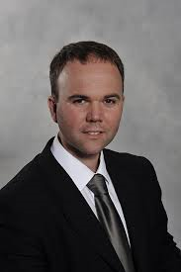
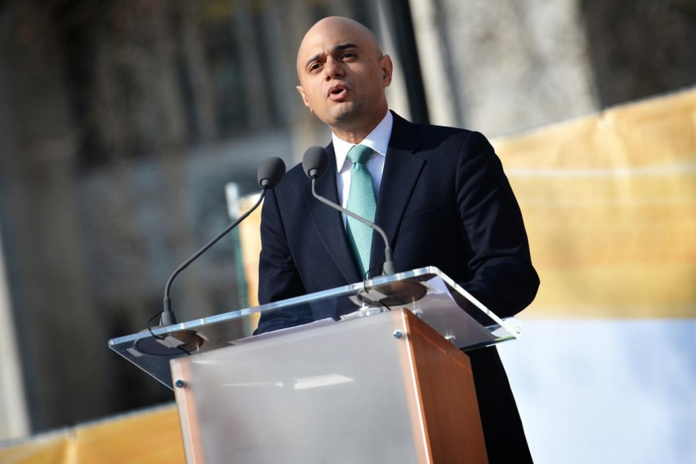
What Government is saying now
Housing is still a top priority
Work with LA’s keen to support growth, and
We need more of all types of housing
“I want more homes for sale; I need more
shared ownership, I need private rent, and I
need more sub-market homes for rent.”
Gavin Barwell – 3/10/2016

Slide 11


Autumn Statement 23 Nov. 2016

Slide 12

Future?

Slide 13

Conclusions
Government has a clear ambition to increase housing
Key themes: speed of delivery and growing capacity
Changing funding and delivery environment
Significant HCA support and resources available
Here to work with partners - responsive to local needs & market conditions
See what the Autumn Statement brings…

