Slide 1
Housing for Older Persons and Living Independently
Rachel O’Connor, SVHA
Sue Sinclair, Homewise

Slide 2
Housing for Older Persons
Some Facts & Figures
2.4 million more older households by 2036
Over 40% of households in social housing have a disability or are over 65. This figures is set to rise
People with dementia over 65 years of age are currently using up to one quarter of hospital beds at one time
Locally, the Strategic Market Housing Assessment identifies that there are high % of pensioner household in the RV (25.8%) than in the NW Region (24.0%) and that the proportion od single pensioner households is 14.6% of the total population of Ribble Valley.

Slide 3
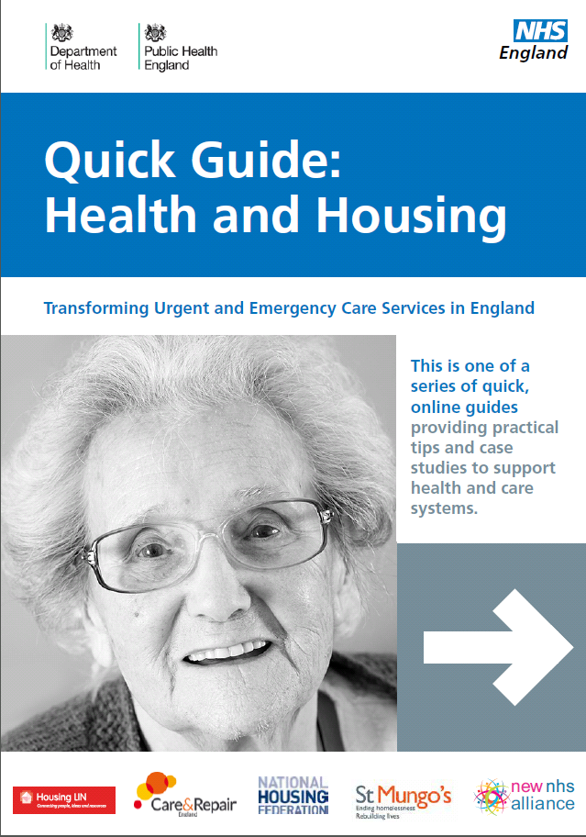
Providing Housing for Older Persons
Challenges facing us due to an ageing population
How can we respond to these challenges?
Is our housing ready for ageing?

Slide 4
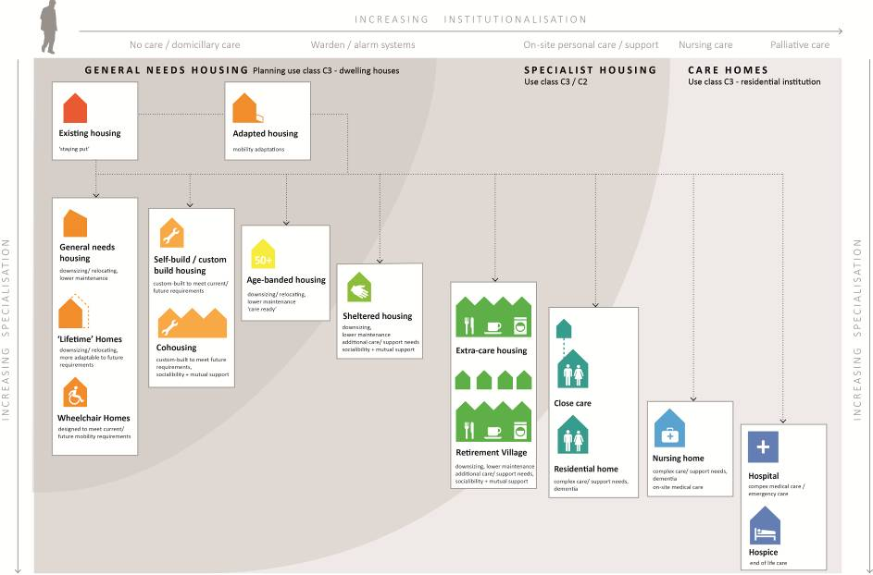
Housing for Older Persons
Housing pathways in later life

Slide 5
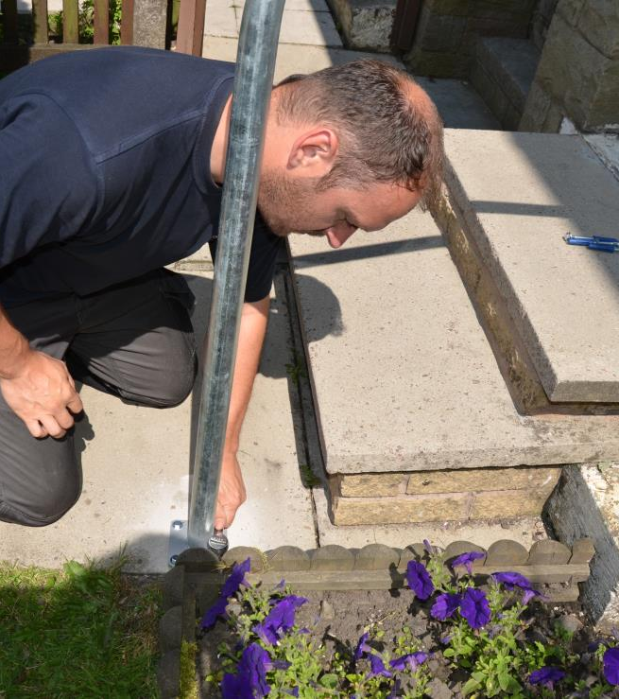
Staying Independent
The NHS spends £1.3bn every year because of poor housing eg trips/falls, energy efficiency/fuel poverty
Role for Adapted Housing
SVHA’s Home Care & Repair & Homewise working in partnership
Delivering LCC contract together
  SVHA - Burnley, Pendle Rossendale
  Homewise – Ribble Valley & Hyndburn

Slide 6
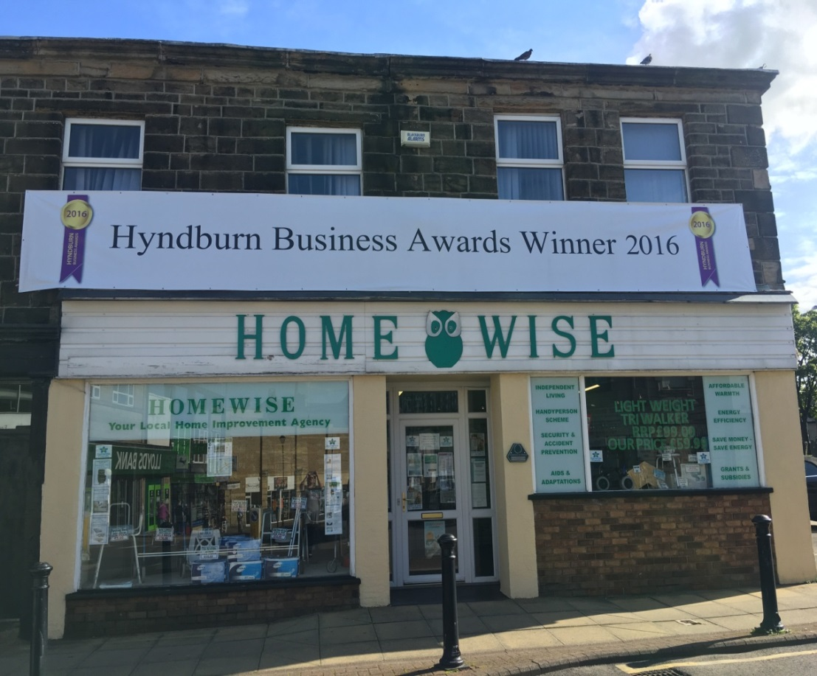
HYNDBURN HOMEWISE SOCIETY LTD
“HOMEWISE”
Non profit making
Organisation:
Registered Society under the Co operative & Community Benefit Society Act 2014
Based at:
2/4 Whalley Road
Accrington

Slide 7
Homewise Housing Advice Agency in Hyndburn and Ribble Valley
Services for the whole community
Impartial advice and support in all aspects of Home Improvement, adaptations, repairs and maintenance
Special assistance for older and disabled people
Staff will:
DISCUSS in detail works required and advise on the best course of action
HELP select a reputable local tradesman
ADVISE on possible sources of funding
ARRANGE for tradesman to carry out work
PROVIDE support throughout the work
ENSURE you are totally happy before payment is made

Slide 8
Small Things Matter
Small Essential Repairs
Free/subsidised for Over 60s
Handyperson Service
Minor Repairs
Falls/Accident Prevention
(free whilst resources last)
Home Security/Distraction
Burglary Kits
(free whilst resources last)

Slide 9
Save Energy Save Money
Grants/Subsidies
Able to Pay Scheme
Affordable Warmth funding
Low Energy Light Bulbs
Energy Switching
Advice /Information

Slide 10
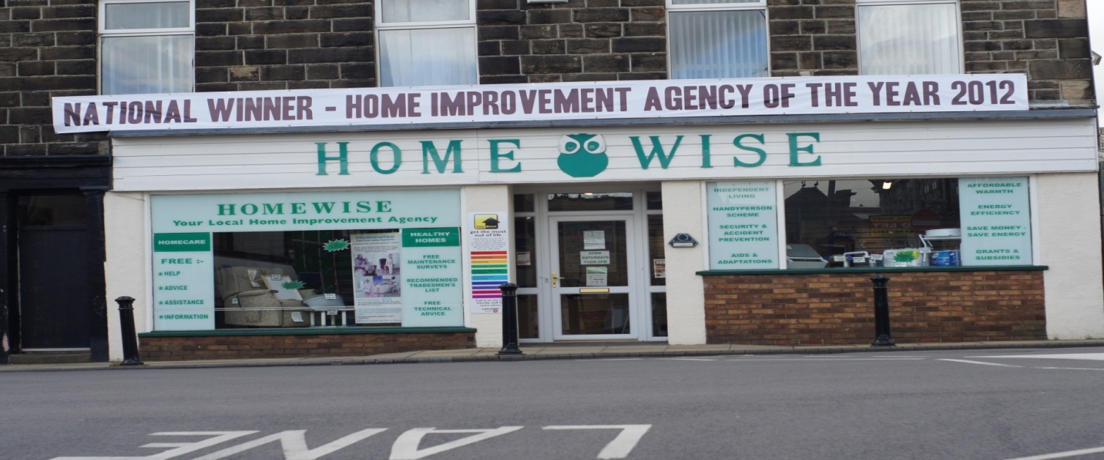
HOMEWISE
Your Independent Living Centre
(non-profit making organisation)
Providing daily living aids to help people remain living in their own home safely and independently

Slide 11

HOMEWISE
Your Independent Living Centre
Well established organisation, passionate about giving people the support they need
Providing options by supplying products & services to enhance independent living
Trusted Assessors to ensure aids are suited to need

Slide 12
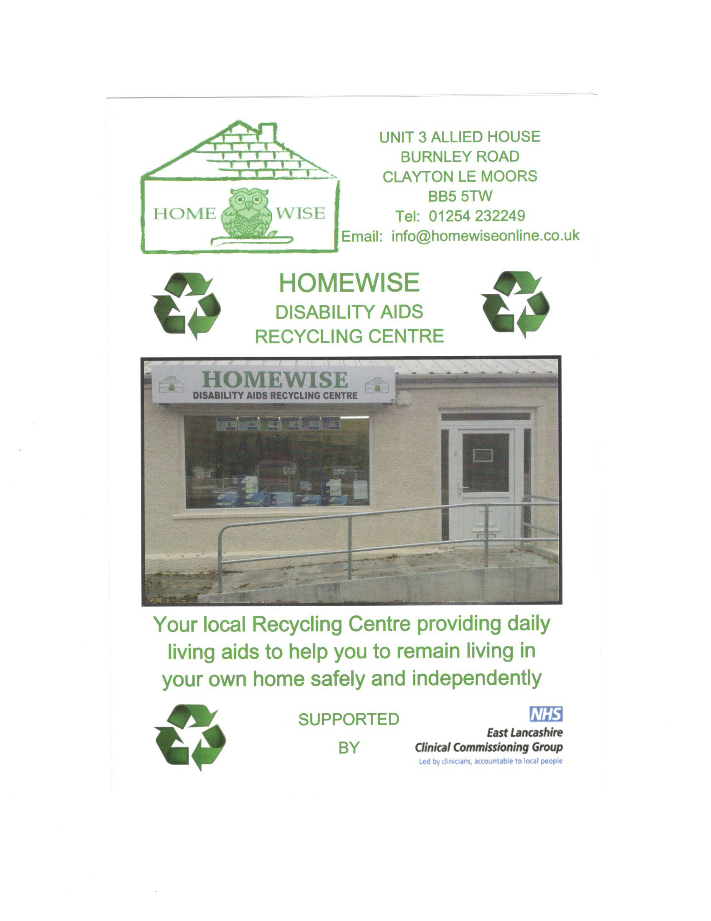

Slide 13
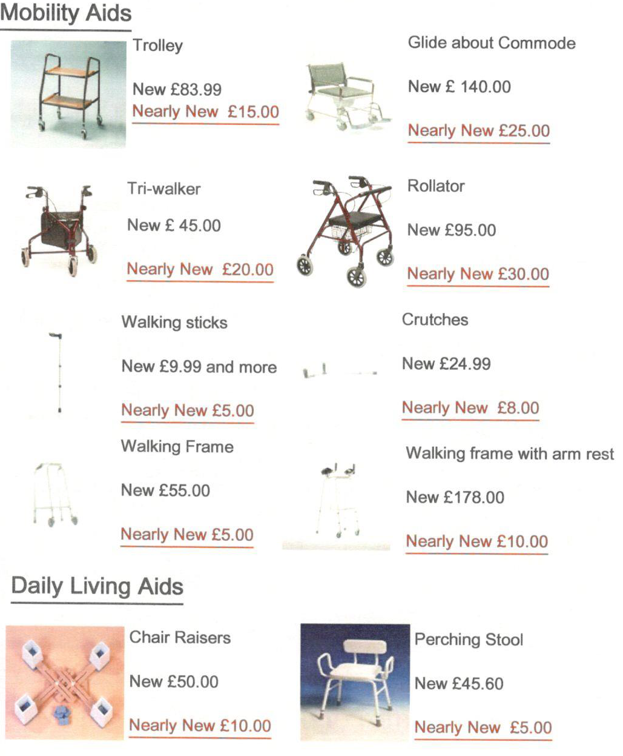

Slide 14
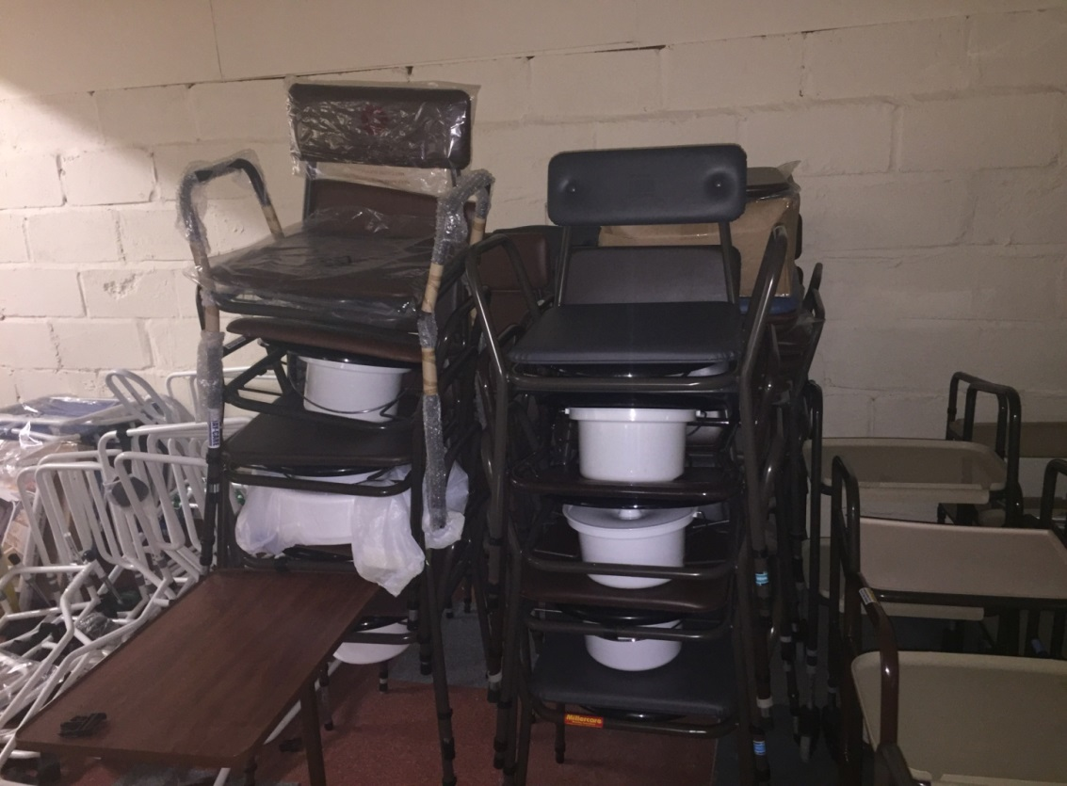
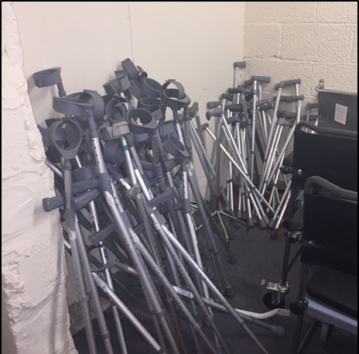
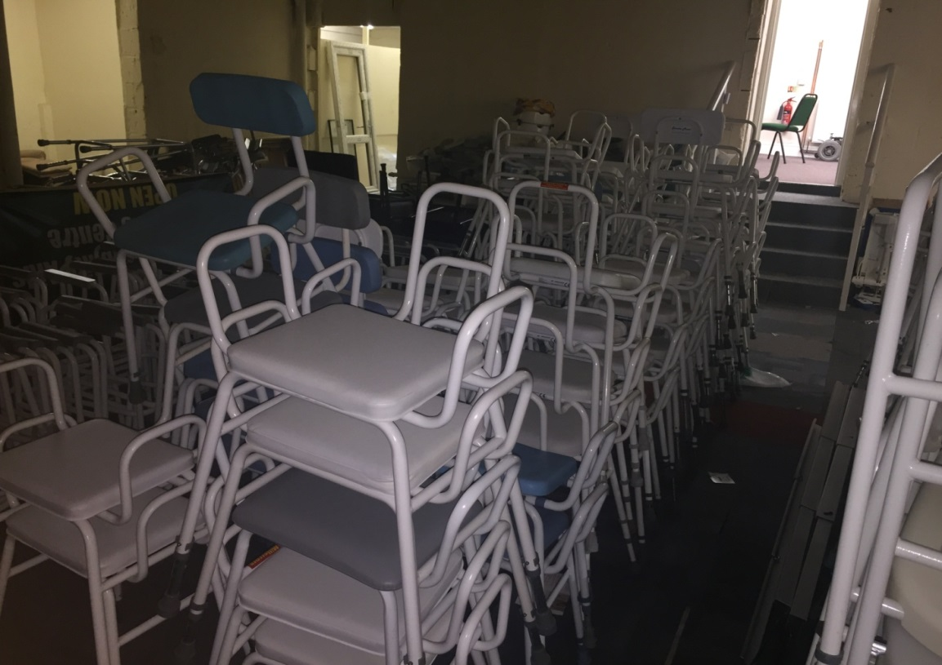
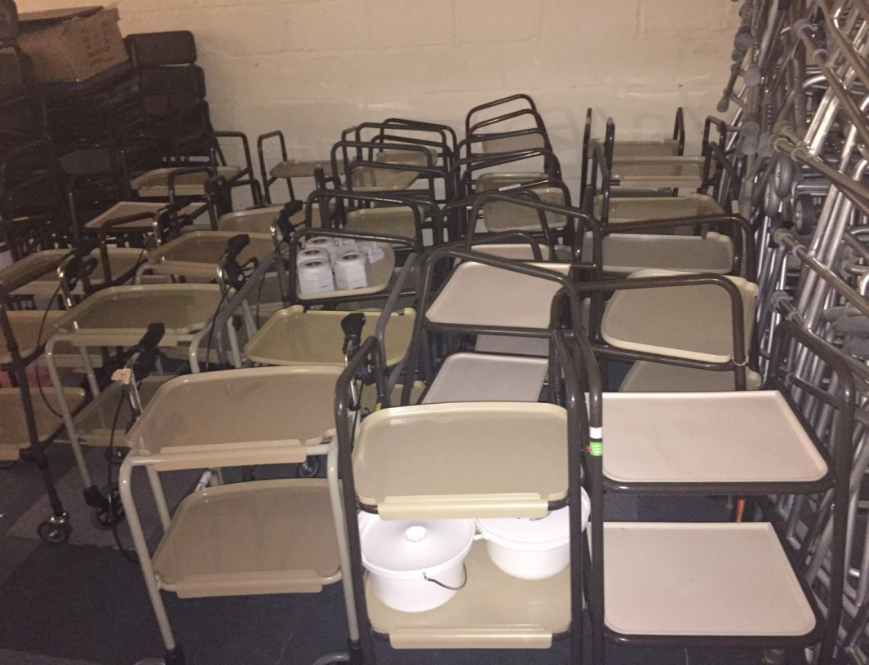

Slide 15
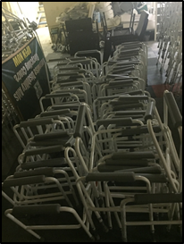
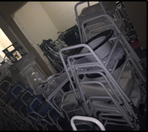
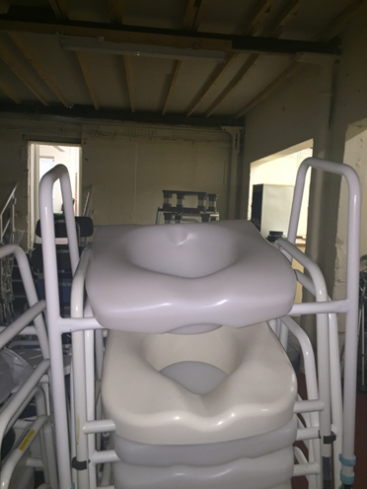
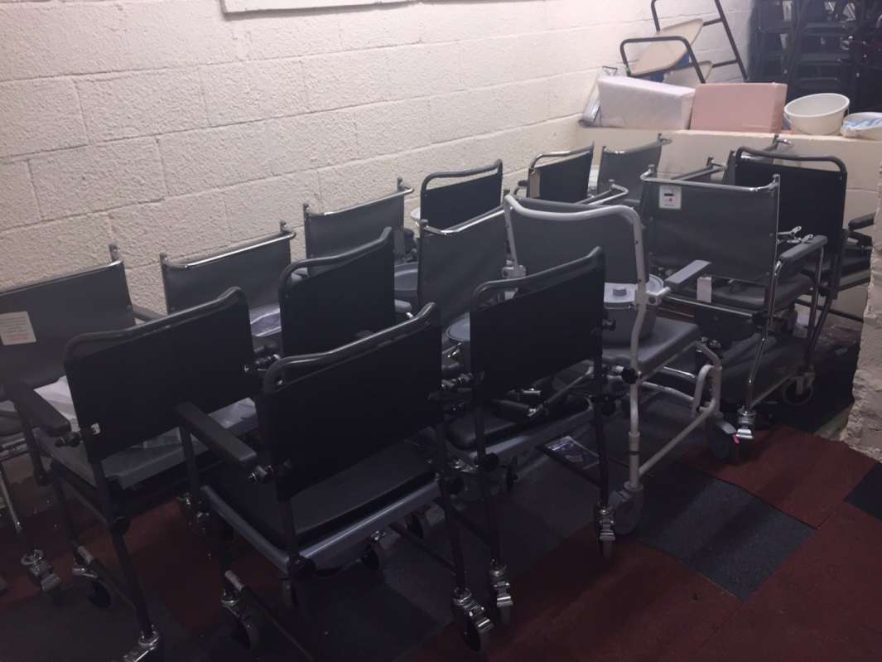
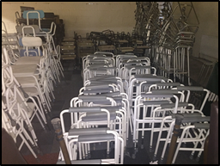

Slide 16


Free advice and support to help people living
with memory issues and their carers to stay
safe in their home
Dementia Friendly Communities
Dementia Action Alliance

Slide 17
No Compromise in Quality
Maintaining Client Satisfaction
78.19% feedback:-
93.20% excellent
6.12% very good
0.68% good
“We can’t promise to help everyone but we do promise to try”

Slide 18

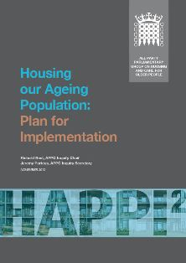
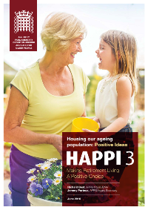
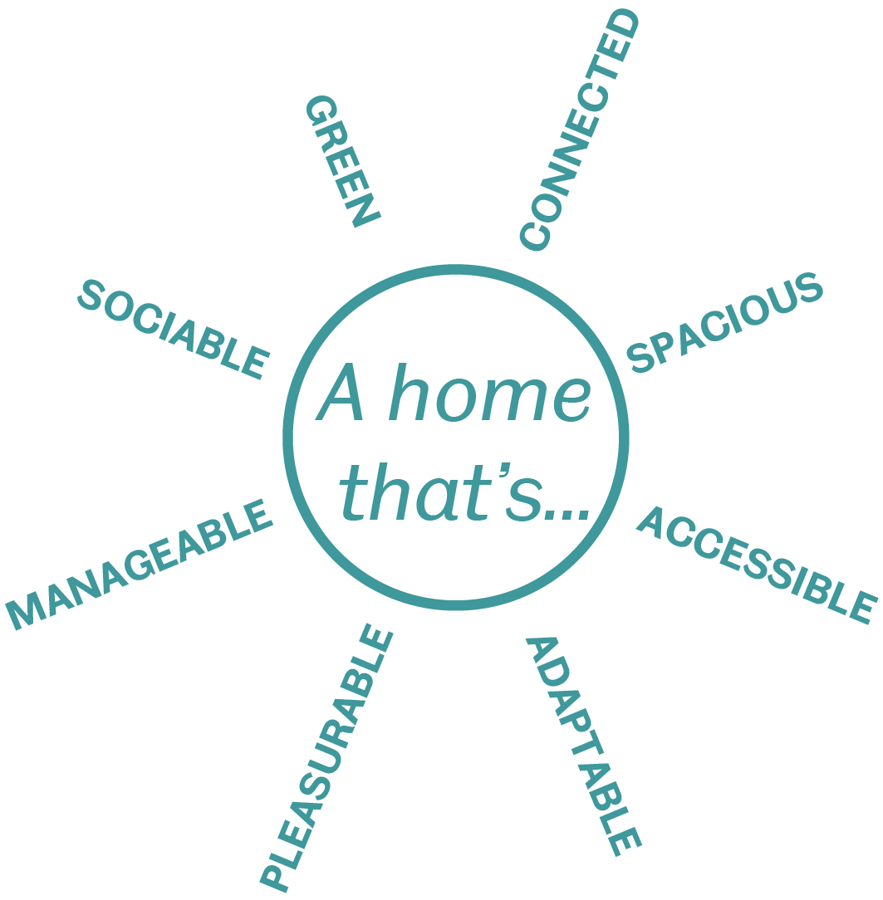
HAPPI - Housing our Ageing Population
HAPPI – Housing our ageing population: panel for innovation – launched 2009, updated 2012 and 2016

Slide 19
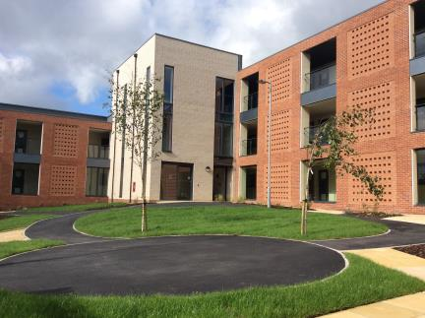
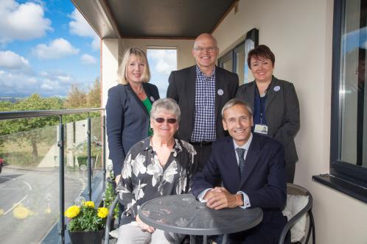

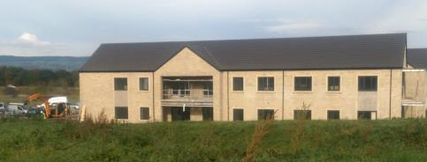
St Vincent’s
HAPPi Schemes

